Slide 1
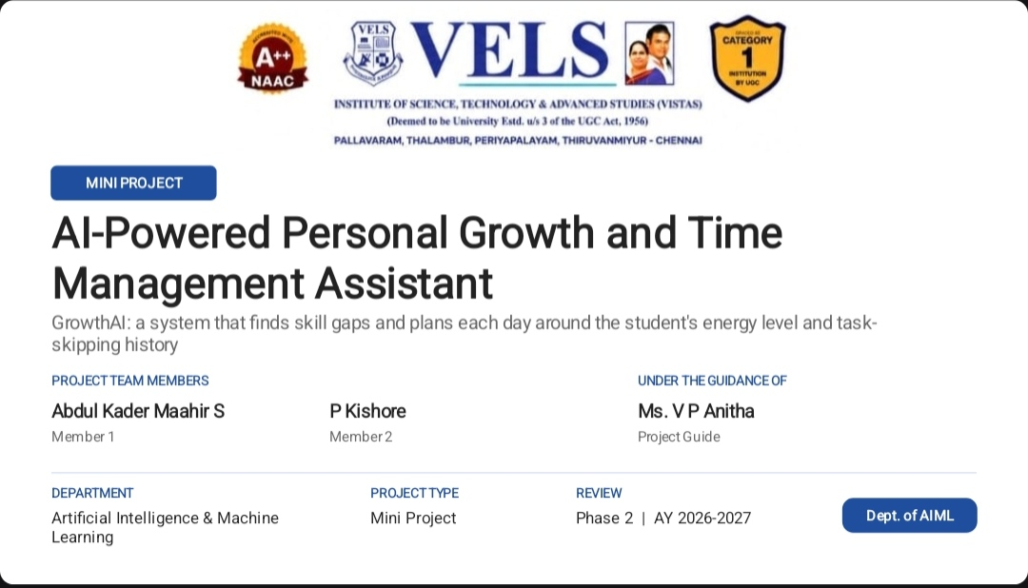
Final Review | AY 2026-2027
Notes:
Title slide. Introduce the team (Abdul Kader Maahir S, P Kishore) and the guide Ms. V. P. Anitha. This is the final review of the mini project.

Slide 2
INTRODUCTION
Students often struggle to identify the skills they need to improve and manage their study time effectively.
2. Traditional study plans do not always suit every student's goals and learning progress.
3. Our AI-powered assistant identifies the skills required to achieve students' career goals.
4. The system provides personalised learning roadmaps based on individual needs
5. Daily task planning and progress tracking help students use their time effectively.
6. Overall, GrowthAI aims to improve learning efficiency, build consistent study habits, and support personal growth.

Slide 3
PROBLEM AND OBJECTIVES
• Students lack a structured approach to personal and professional development.
• Choosing which learning activities to focus on can be confusing.
• Fixed schedules are difficult to follow when daily routines change.
• Students may lose motivation when they cannot see their progress clearly.
• Most basic planners focus on scheduling rather than personalised learning support.
• To connect students’ career interests with relevant learning activities.
• To recommend tasks based on priority and available study time.
• To adjust daily plans according to task completion and learning behaviour.
• To provide AI-based guidance for learning-related questions.
• To present progress insights that help students make better study decisions.
• To encourage consistent learning through a structured and personalised system.
THE PROBLEM
OBJECTIVES
Notes:
Learners do not know their gaps; plans ignore energy and free time; skipping is never tracked. GrowthAI addresses each of these.

Slide 4
ABSTRACT
GrowthAI is an AI-powered personal growth and time management assistant designed to help students achieve their career goals through structured and personalised learning. Many students find it difficult to identify the skills they need to improve, organise their study schedules, and maintain consistent learning habits. To address these challenges, GrowthAI connects career goals with required skills and conducts timed Multiple Choice Question (MCQ) assessments to evaluate students’ current knowledge. Based on assessment results, the system identifies areas for improvement and generates personalised learning roadmaps with suitable daily tasks. The adaptive planner considers available study time, self-reported energy levels, and previous task history to organise daily learning activities. The system also includes task completion tracking, skip-reason recording, progress insights, AI-assisted skill and question generation, and a Machine Learning-based task completion prediction model. By bringing these features together in one platform, GrowthAI aims to support effective time management, encourage consistent study habits, improve learning organisation, and promote continuous personal and professional development.
Notes:
Read the abstract in your own words. Mention that the ML part is advisory and the AI Coach is future work.

Slide 5
LITRATURE SURVEY
RESEARCH (Author, Year)
• Benjamin S. Bloom (1984) – The 2 Sigma Problem
• Edwin A. Locke and Gary P. Latham (2002) – Building a Practically Useful Theory of Goal Setting and Task Motivation
• Piers Steel (2007) – The Nature of Procrastination
• Individual tutoring can be difficult to provide to large numbers of students.
• Goal-setting principles alone do not provide an automated and personalised daily planning system.
• The review does not evaluate an AI-based student task planner or establish one solution for every learner.
• Individual tutoring and mastery learning can improve students’ academic performance.
• Clear goals, challenging tasks, and feedback can improve motivation and task performance.
• Procrastination is associated with task difficulty, impulsiveness, and low self-confidence.
LIMITATION
KEY FINDINGS

Slide 6
TECHNOLOGIES USED
Part | Technology | Used for
Frontend | React 19 + Vite | Screens the learner sees
Backend | FastAPI + Uvicorn (Python) | APIs and business rules
Database | PostgreSQL (Neon), 14 tables | Stores all data
Data access | SQLAlchemy + psycopg2 | Runs SQL from Python
Security | bcrypt, JWT (HS256) | Password hashing and login token
Advisory ML | scikit-learn | Task-completion estimate (advisory only)
Content prep | Gemini API | Prepares assessment questions offline
Planned | LLM AI Coach | Future work, not active
Note: planning is rule-based. The ML model only advises and never changes the plan by itself.
Notes:
Gemini is used only to prepare assessment content, not at run time for the learner.

Slide 7
BASE PAPER
Title: An Intelligent Personal Assistant for Task and Time Management
Authors and Year: Karen Myers et al. (2007)
Methodology:
• Designed an AI-based personal assistant called PExA.
• Integrated AI agents for task management, time scheduling, monitoring, and prediction.
Key Findings:
• AI can help users organise tasks and manage time commitments.
• Personalised scheduling and task monitoring can support user productivity.
Limitations:
• Some system actions were simulated rather than fully implemented.
• A comprehensive evaluation of the complete system had not yet been conducted.
Relevance to GrowthAI:
• Supports the use of AI for task management and time planning.
• GrowthAI extends this idea towards students through skill assessments, personalised learning roadmaps, adaptive daily tasks, and progress tracking.
DOI: https://doi.org/10.1609/aimag.v28i2.2039

Slide 8
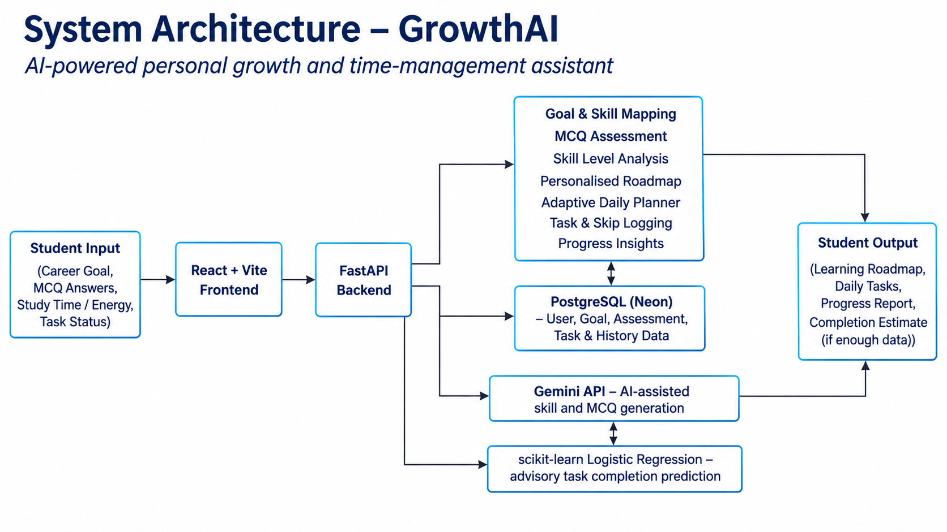
SYSTEM ARCHITECTURE
Notes:
Four layers, top to bottom. Every request carries the JWT. Dashed = offline content preparation. Amber = planned, not active.

Slide 9
COMPLETE PROCESS FLOW
STEP 1
STEP 2
STEP 3
STEP 4
Register / Login
Create Goal
Take Assessment
Skill-Gap Report
Password hashed, JWT issued
Skills for the goal linked
Timed, shuffled questions
Beginner / Inter / Advanced
STEP 5
STEP 6
STEP 7
STEP 8
Roadmap
Daily Plan
Do and Log Tasks
Adapt
Weak skills first
Sized by energy and skips
Done, or skip with reason
Next plan easier or harder
Continuous loop: step 8 feeds step 6, so every new day is planned from the latest logs.
Notes:
Eight steps. Step 8 feeds back into step 6, so each new day uses the latest logs.

Slide 10
LIST OF MODULES
No | Module | What it does | Status
M1 | Authentication | Register, login, secure every API | Completed
M2 | Goals and Skills | Save a goal and link its skills | Completed
M3 | Skill Assessment | Timed test that scores each skill | Completed
M4 | Gap and Roadmap | Find weak skills, order the learning steps | Completed
M5 | Daily Planner | Create today's tasks from the skill gaps | Completed
M6 | Tracking and Adaptive | Energy, task logs, skip reasons, difficulty advice | Completed
M7 | Insights and Progress | Completion, skip patterns, progress view | Completed
M8 | Advisory ML | Task-completion estimate from history | Completed
M9 | AI Coach | Conversational guidance | Completed
Notes:
Eight modules are implemented. Only the AI Coach is future work.

Slide 11
MODULES
User Authentication & Profile – Provides secure registration, login, and profile management.
2. Goal & Skill Mapping – Connects students’ career goals with the skills required to achieve them.
3. MCQ Assessment – Conducts timed tests to evaluate students’ current knowledge.
4. Skill Analysis & Learning Roadmap – Analyses assessment scores and creates a personalised learning path.
5. Adaptive Daily Planner – Generates daily tasks based on available time, energy level, and previous task history.
6. Task & Skip Management – Records completed and skipped tasks along with skip reasons.
7. Progress Tracking & Insights – Displays learning progress, task completion history, and performance summaries.
8. AI-Assisted Content Generation – Uses Gemini API to assist in generating relevant skills and assessment questions.
9. ML-Based Task Prediction – Uses Logistic Regression to estimate task completion when sufficient historical data is available.

Slide 12
SECURE TIMED ASSESSMENT
How the test is protected
120 s
Timer runs on the server clock, not the browser
Options shuffled with HMAC-SHA256, recomputed on demand
Presented letters translated back to stored letters
Correct answer is never sent to the browser
Answers are idempotent, so resubmitting is safe
Resume continues with the original clock
Copy, cut and right-click disabled; tab switches are informational only
per question
+30 s
grace time
5
attempts per goal
Notes:
The correct answer never reaches the browser. Shuffle order is recomputed from a secret key, not stored.

Slide 13
LEVELS, ROADMAP AND DAILY PLANNER
SKILL LEVELS
ROADMAP ORDER
DAILY PLANNER
Below 40%
1. Gap skills first (Beginner and Intermediate share a priority)
2. Not assessed skills
3. Advanced skills last
Ties broken by skill importance
Low energy AND skips > 40%
Beginner
EASY · 20 min
One of the two
40% to below 70%
MEDIUM · 40 min
Intermediate
Neither
70% or above
HARD · 60 min
Advanced
One task per skill, capped by the learner's daily free minutes (default 60).
Notes:
All three are simple rules in code. Skip rate = (skipped + postponed) divided by all task logs.

Slide 14
ADVISORY MACHINE LEARNING
Model
9 input features
StandardScaler + Logistic Regression (scikit-learn) predicts whether a task will be completed.
Task duration, and a duration-missing flag
Daily available minutes
Energy value
Prior completion rate and prior skip rate
Skips in the last 5 tasks
Difficulty value
Productive-time match
Rules for using it
Trains only with at least 6 outcomes, both classes present
Holdout metrics only with at least 10 outcomes, 2 per class
Advisory only; the rule-based planner stays in control
Notes:
The model never changes the plan. It only shows an estimate. Do not claim an accuracy number: there is not enough real data yet.

Slide 15
DATABASE DESIGN
Group | Tables | Purpose
Users (2) | users, user_profiles | Login details and daily free minutes
Goals and skills (3) | goals, skills, goal_skills | Goals and the skills each needs
Assessment (4) | assessment_questions, assessment_attempts, assessment_answers, skill_assessments | Questions, attempts, answers and scores
Tasks and tracking (5) | tasks, task_logs, energy_checkins, habits, progress | Daily tasks, what happened to them, energy
Users
Goals
Skills
Assessment
Roadmap
Tasks
Logs + Energy
Progress
Data flows left to right: from the user to progress reports.
Notes:
14 tables on PostgreSQL (Neon), raw SQL through SQLAlchemy.

Slide 16
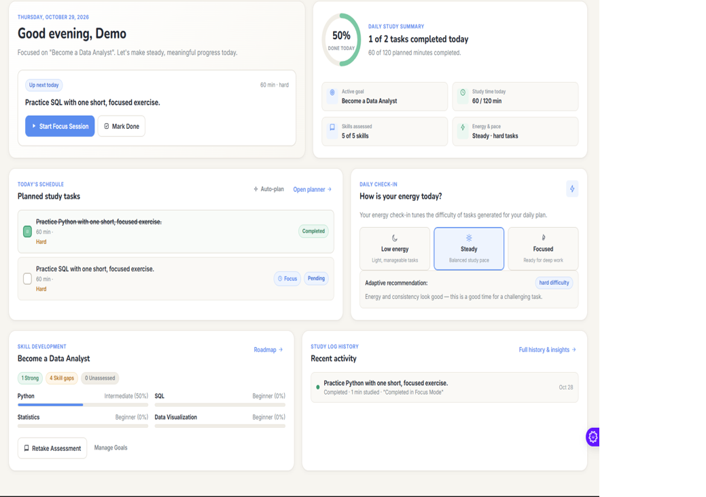
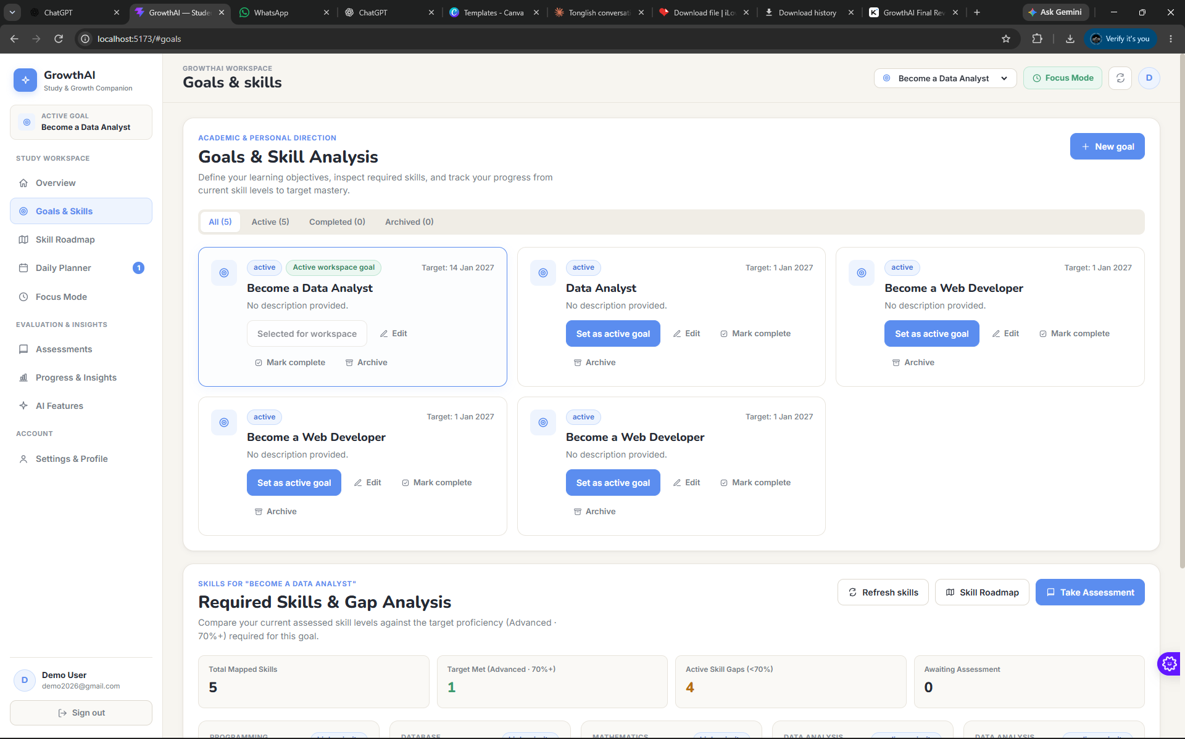
APPLICATION SCREENSHOTS (1/3)
Dashboard
Goals
Paste the real app screenshot here
Paste the real app screenshot here
Notes:
Explain what the screen does while showing it. Use the real screenshots only.

Slide 17
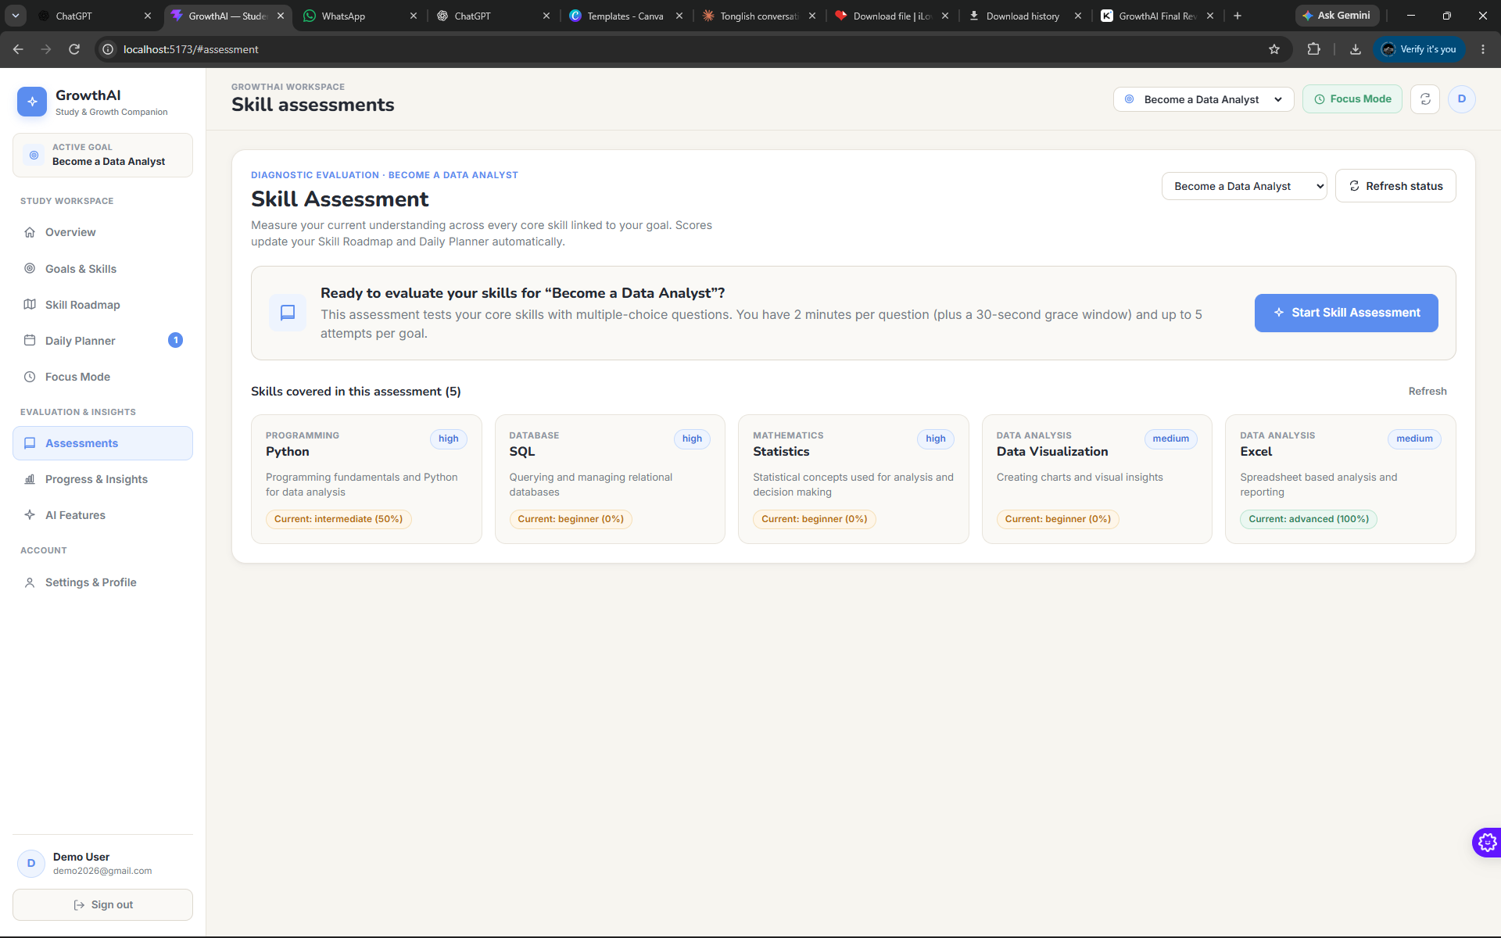
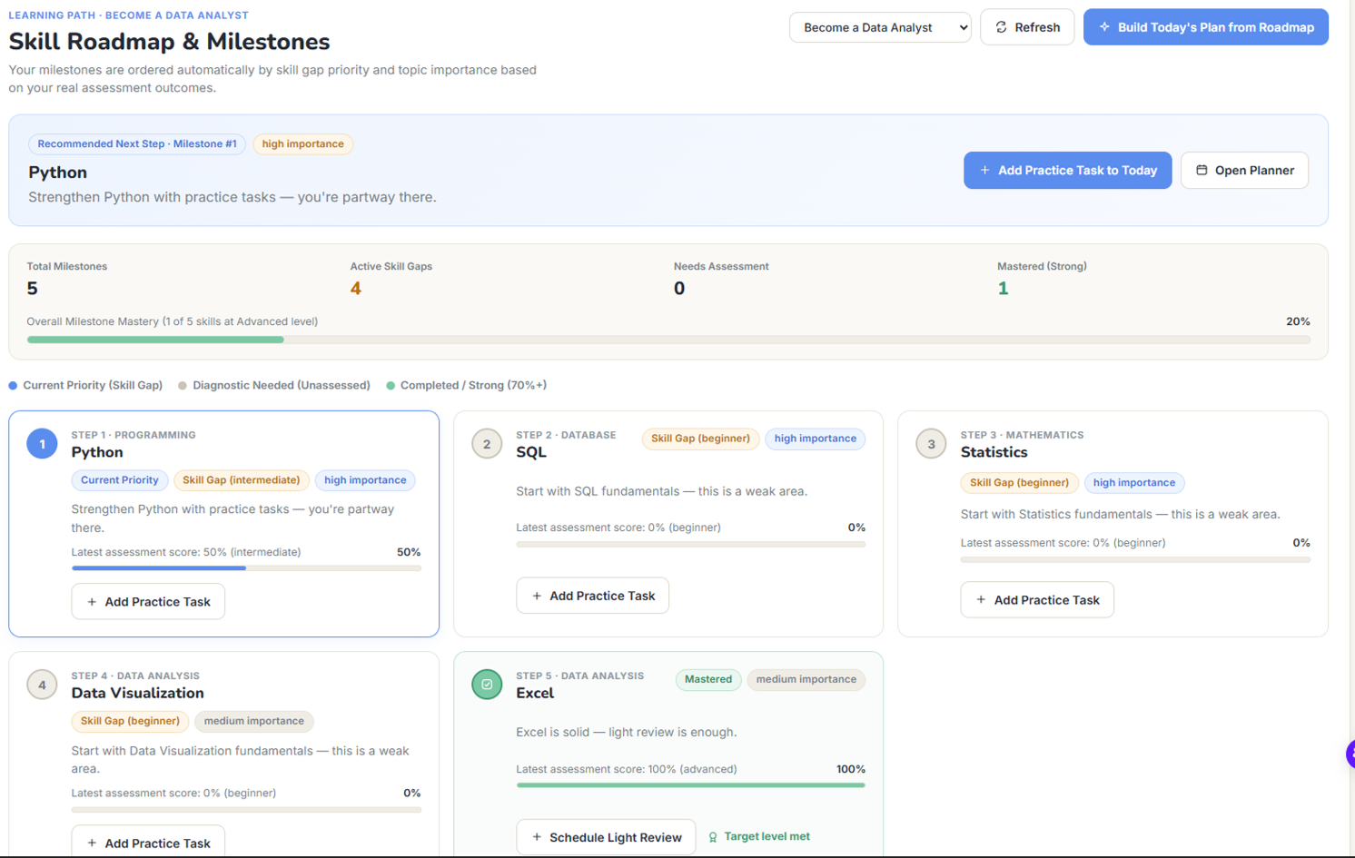
APPLICATION SCREENSHOTS (2/3)
Skill Assessment
Roadmap
Paste the real app screenshot here
Paste the real app screenshot here
Notes:
Explain what the screen does while showing it. Use the real screenshots only.

Slide 18
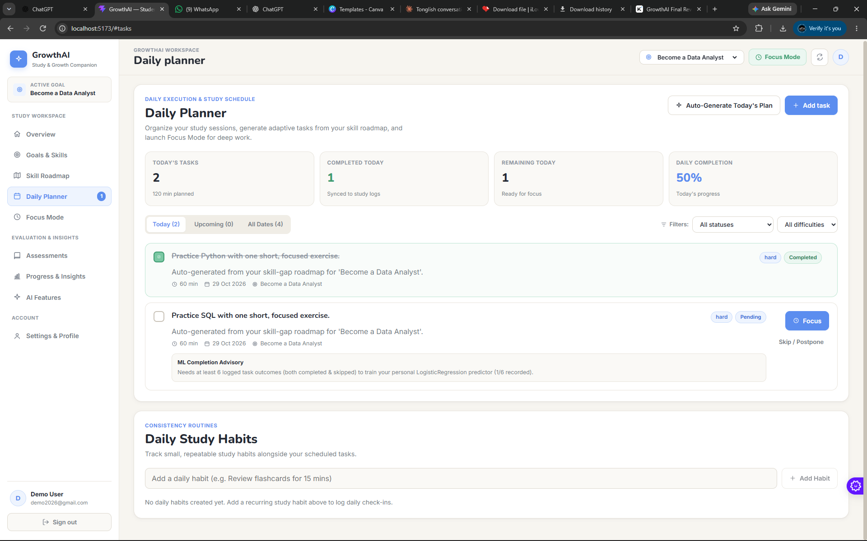
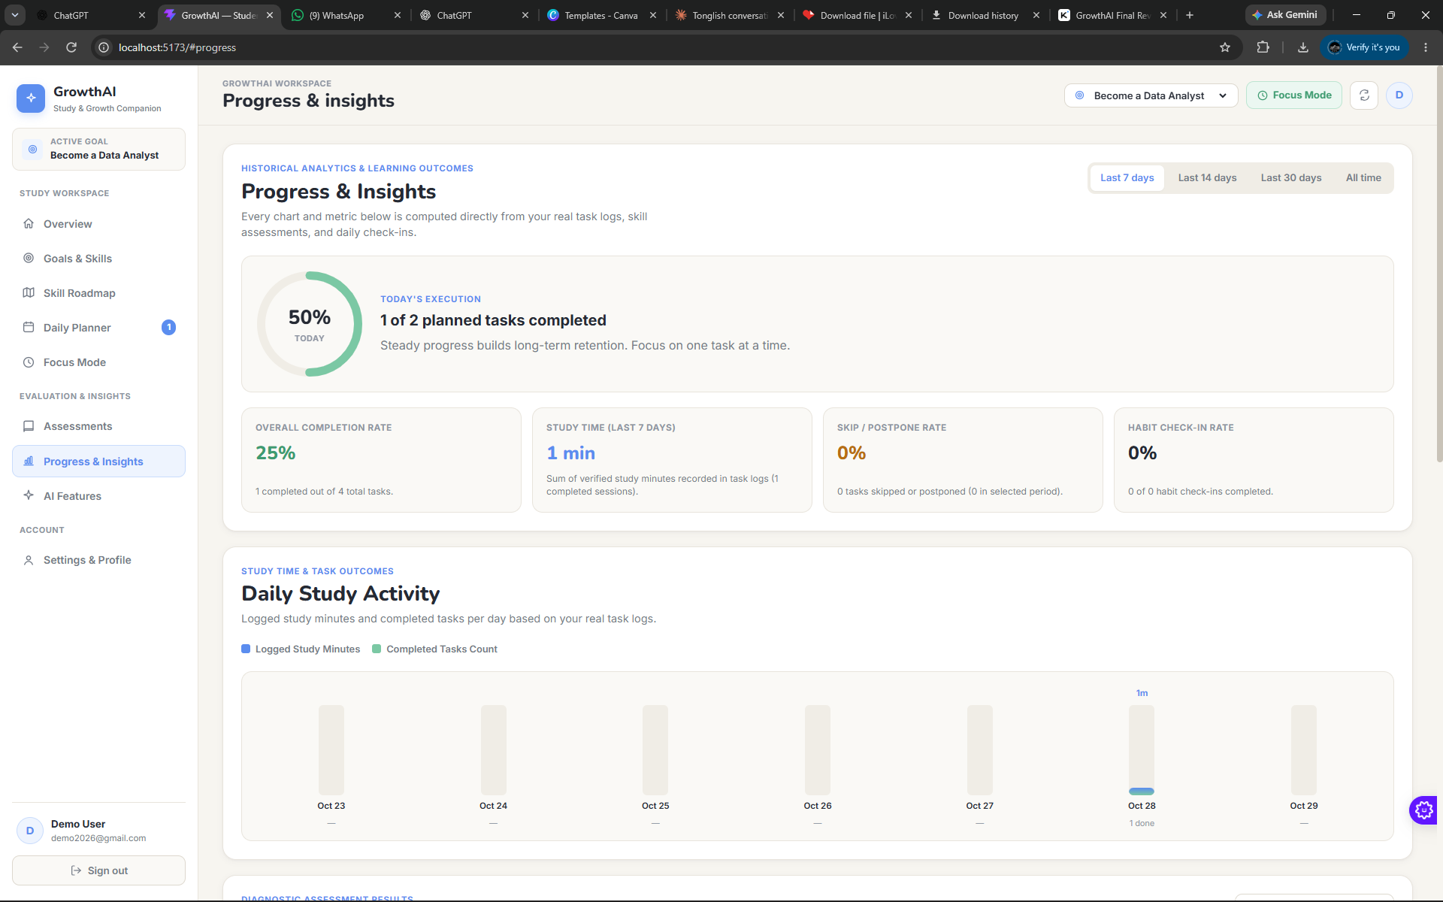
APPLICATION SCREENSHOTS (3/3)
Daily Tasks
Progress and Insights
Paste the real app screenshot here
Paste the real app screenshot here
Notes:
Explain what the screen does while showing it. Use the real screenshots only.

Slide 19
TESTING AND RESULTS
Area | What was checked | Status
Login / JWT | Hashing, token expiry, ownership checks | Functional test
Assessment | Server timer, shuffle, answer translation | Functional test
Levels and roadmap | Threshold and ordering rules | Rule in code
Daily planner | Difficulty rule, 20/40/60 min | Rule in code
Advisory ML | Trains only with enough outcomes | Functional test
One test attempt (score %)
Live check pending for AI-prepared questions on a brand new goal.
Overall 2 of 7 correct = 28.57%
Skills below 40% = Beginner, so the roadmap puts them first.
Notes:
The 28.57% is one developer's attempt, used to check the pipeline. It is not a user study and not a model accuracy.

Slide 20


PROJECT GANTT CHART: IMPLEMENTATION STATUS
Development phase
Stage 1
Stage 2
Stage 3
Stage 4
Stage 5
Stage 6
Stage 7
1. Requirements Analysis
✓
2. System Architecture and Database Design
✓
3. Backend API Development
✓
4. Authentication and Security
✓
5. Goal and Skill Mapping
✓
6. Timed Skill Assessment
✓
7. Skill-Gap Analysis and Roadmap
✓
8. Adaptive Daily Planner
✓
9. Task Logging and Progress Insights
✓
10. Machine Learning Prediction Module
✓
11. React Frontend Development
In progress
12. AI COACHING integration
✓
13. Automated Testing and Validation
almost
14. Final Integration and Review
almost
✓ Completed (implemented and verified)
In progress
Final validation (few things)
Phase-based, no calendar dates
Notes:
Phase-based development sequence, no calendar dates. Green = implemented and verified against the report and tests. Blue final-validation rows turn green only after the live end-to-end test passes. Frontend is still in progress.

Slide 21
PROJECT DEMO STEPS
01
02
03
Register and Login
Create Goal
Take Assessment
Get the JWT token
Become a Data Analyst; skills link automatically
Timed test with server verification
04
05
06
View Roadmap
Generate Daily Plan
Log and Adapt
Skill-gap report, weak skills first
20/40/60 min tasks by energy
Done or skip with reason, see new advice
Backup plan: the Swagger page at /docs verifies every endpoint live.
Notes:
Backup plan: open /docs (Swagger) to show each API live.

Slide 22
CONCLUSION, LIMITS AND FUTURE WORK
CONCLUSION
LIMITATIONS
FUTURE WORK
GrowthAI turns a goal into skill gaps and a daily plan
Skipping is tracked with reasons
Plan adapts to energy and skip rate
Small question bank
ML is advisory, little real data yet
No user study yet
AI Coach
Weekly reflection
Real user study
GOAL
SKILL GAP
ROADMAP
DAILY PLAN
TRACKING
ADAPTATION
THANK YOU
Notes:
Close with the honest limits, then thank the panel.

